Slide 1

WAVCON TELECOM ANALYSIS
Revealing Insights Before and After the 5G Era
AVINASH GADPAYLE

Slide 2
Agenda
Introduction
Impact
Market Share Impact
Plans
Assessing the Impact of 5G Launch on WaveCon Telecom's May Introduction
Final
Recommendation

Slide 3
WaveCon Telecom
WaveCon Telecom is a leading telecommunication company in India, which provides telecom services to individuals and businesses.
WaveCon is the 3rd largest telecom service provider in terms of market share.
WaveCon has recently upgraded its network from 4G to 5G

Slide 4
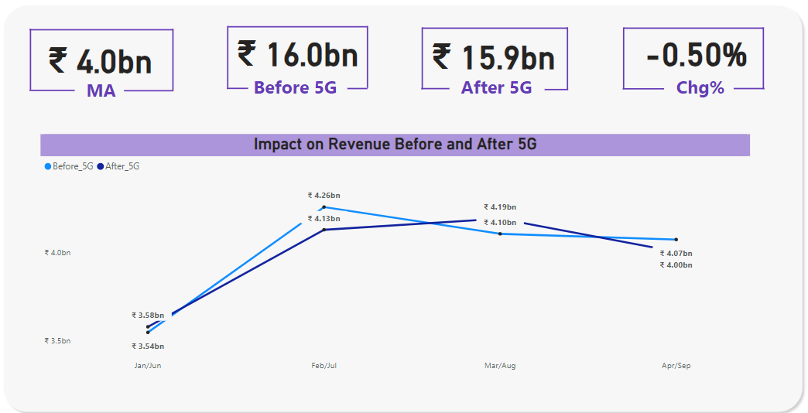
Impacts
After the 5G launch the revenue has decreased by 0.5%.

Slide 5
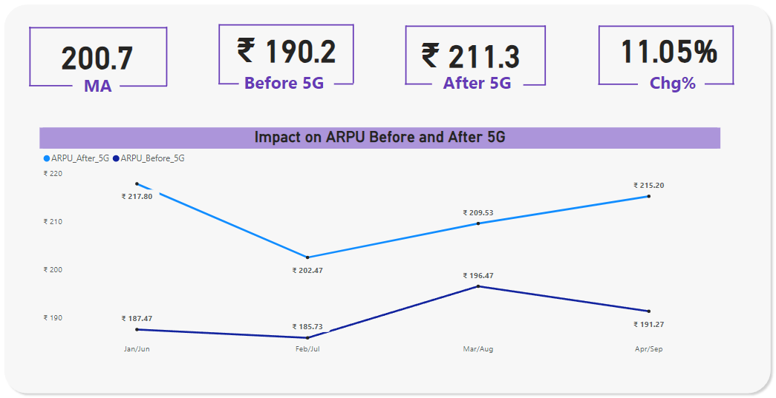
Impacts
After the 5G launch, average revenue per user increased by 11.05%

Slide 6
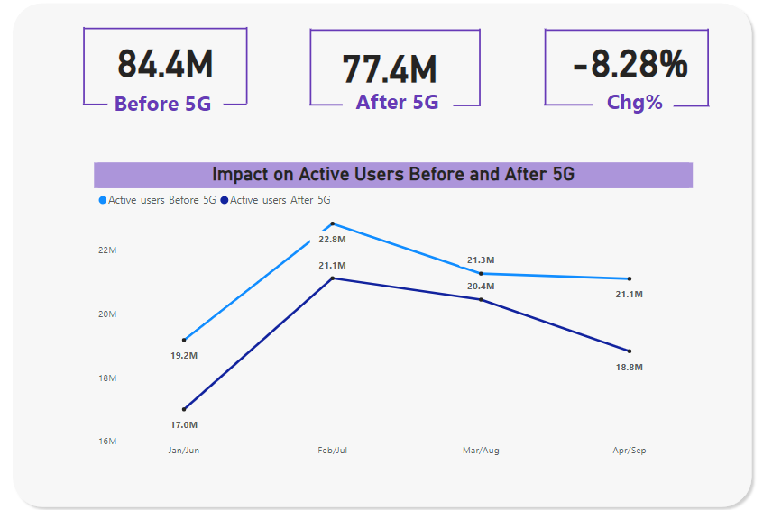
Impacts
After the 5G launch, Total active users decreased by 8.02%.

Slide 7
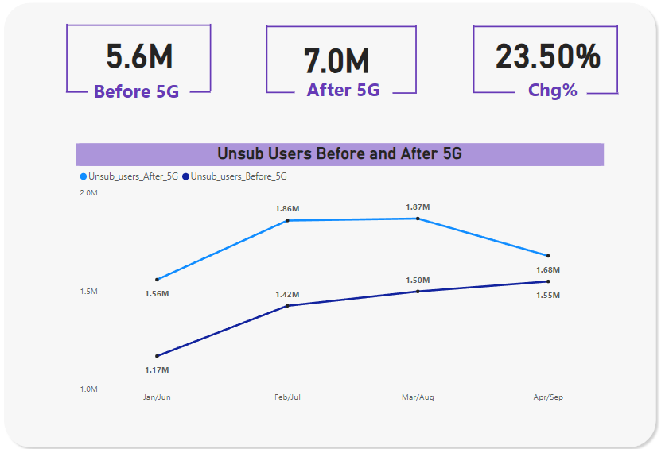
Impacts
After the 5G launch, 23.50% more users unsubscribed WaveCon.

Slide 8
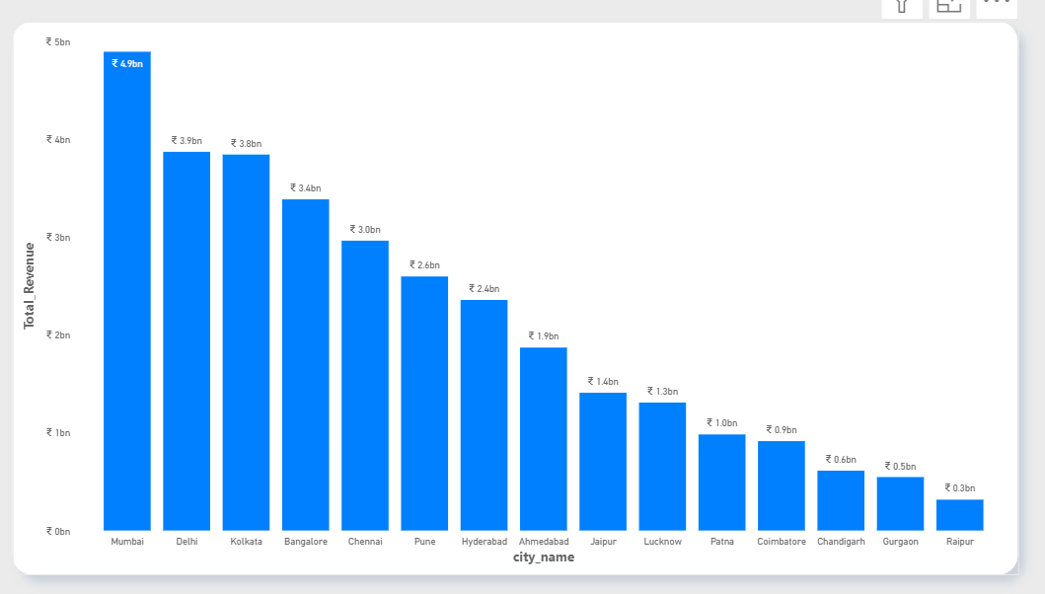
WaveCon Cities impact

Slide 9
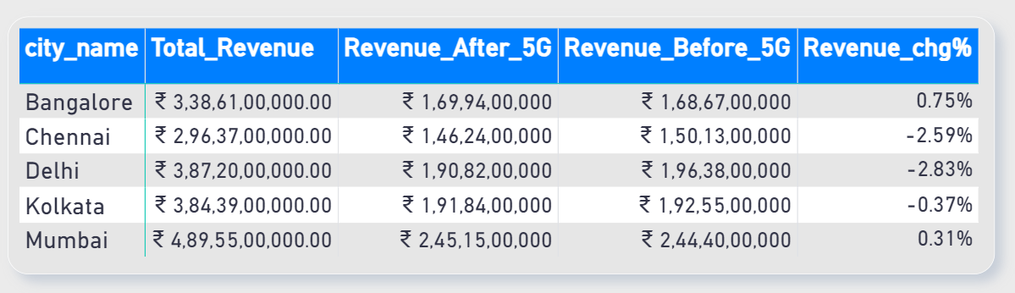
Impacts
Revenue Decline in Key Cities: We've observed a concerning trend in our top cities, specifically Delhi and Chennai, where revenue has significantly declined.
Delhi's Revenue Ranking: Delhi, which was previously our second-highest revenue generator, has experienced a substantial drop in revenue.
ARPU in Delhi: Interestingly, even though Delhi held a high revenue rank before the introduction of 5G, the Average Revenue Per User (ARPU) in Delhi now ranks among the bottom three when compared to the 15 cities we operate in.

Slide 10
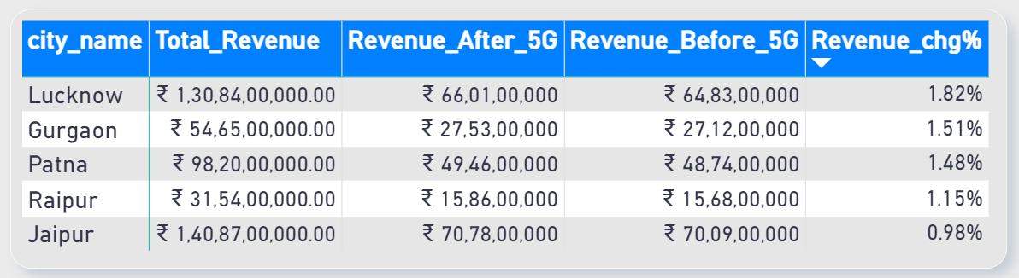
Impacts
Cities with Strong Revenue: Lucknow, Gurgaon, and Patna have shown promising revenue performance, indicating that our business is thriving in these areas.
Active Users Decline: However, it's concerning to note that the total number of active users has been decreasing in all three cities, except for Lucknow.
Financial Challenges: In each of these cities, we are facing significant financial challenges that are impacting our profitability, leading to losses in various ways.

Slide 11
Takeaways
Positive Trends:
Significant Increase in Average Revenue Per User (ARPU)
Challenging Trends:
Declining Overall Revenue
Decreasing Monthly Active Customers
Insights:
Some users are opting for more expensive plans, boosting ARPU.
A significant portion of our customer base is dissatisfied, leading to:
1. Increased Churn
2. Reduced Active Customers

Slide 12
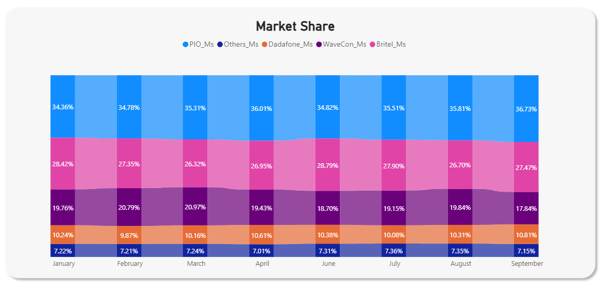
Market Share
WaveCon‘s market share has fallen the most, with a loss of nearly 2 percent of our market share.
To stay competitive We must conduct a thorough analysis
1. Competitor Analysis
2. Service Quality Assessment
3. Pricing Strategy Alignment
4. Feedback and Continuous
Improvement

Slide 13
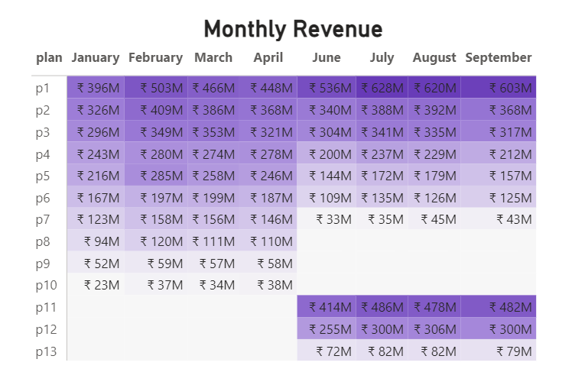
Plans

Slide 14
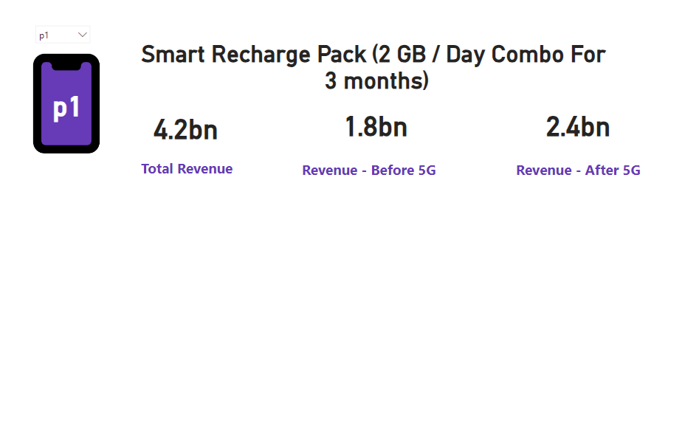
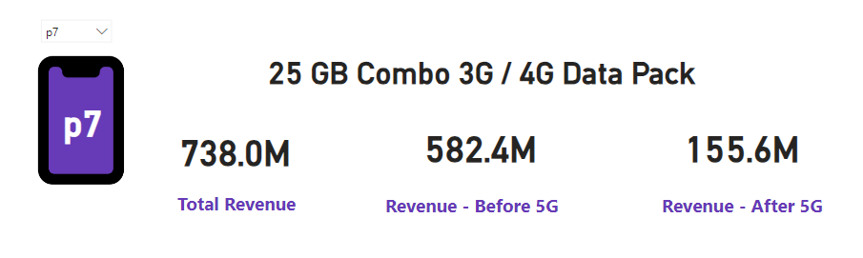
Daily renewal plans, such as P1 with its 2GB data per day, have been consistently outperforming fixed data and talk time plans.
Continuing plans like P5 and P6, which offer flexibility and substantial data allowances, make sense in today's competitive market.
On the other hand, discontinuing fixed plans like P7, which provide limited validity and data/talk time benefits, is a strategic move to cater to the evolving needs of our customers.
.

Slide 15
Final Recommendation
Smart Pricing Strategy: We'll delve into competitive analysis to fine-tune our pricing, ensuring that our plans remain attractive while still ensuring profitability.
2. Data-Driven Promotions: Let's ramp up marketing efforts for plans like P1 and P11, featuring extended data allowances and enhanced validity to entice customers.
3. Personalized Customer Engagement: We'll employ tailored messaging, taking into account each customer's unique preferences and habits for a more engaging experience.
4. Comprehensive Bundled Offers: To sweeten the deal, we can create enticing bundles by coupling daily renewal plans with cost-effective data boosters, providing additional value to ongoing subscriptions.
5. Customer Appreciation Programs: Initiating loyalty programs to reward our dedicated clientele with exclusive discounts will foster stronger, long-lasting relationships.

Slide 16




Thank you
Avinash Gadpayle
agadpayle26@gmail.com

